Slide 1
STOCK PORTFOLIO MANAGEMENT SYSTEM
Group 6

Slide 2

GROUP MEMBERS
Shruthi Kavishetti
Devi Priya Putta
Goli Varsha
Guna Swetha Madaka
Jannu Deepthi

Slide 3
PROJECT TIMELINE
07/12/22
SRS RELEASE, DESGN
09/12/22
Code Implementation
11/12/22
Unit testing planning and implementation
12/12/22
Integration testing planning and implementation

Slide 4
TABLE OF CONTENT
Understanding the problem statement.
Planning and Design
Coding and Execution
Testing
Conclusion

Slide 5
Understanding the problem statement

Slide 6
Introduction:
The stock management system must take care of sales information of the company and must analyse the potential of the trade. It maintains the number of items that are added or removed. The sales person initiates this Use case. The sales person is allowed to update information.
The entire process of Stock management is done in a manual manner Considering the fact that the number of customers for purchase is increasing every year, a maintenance system is essential to meet the demand. So this system uses several programming and database techniques to elucidate the work involved in this process

Slide 7
Planning and Design

Slide 8
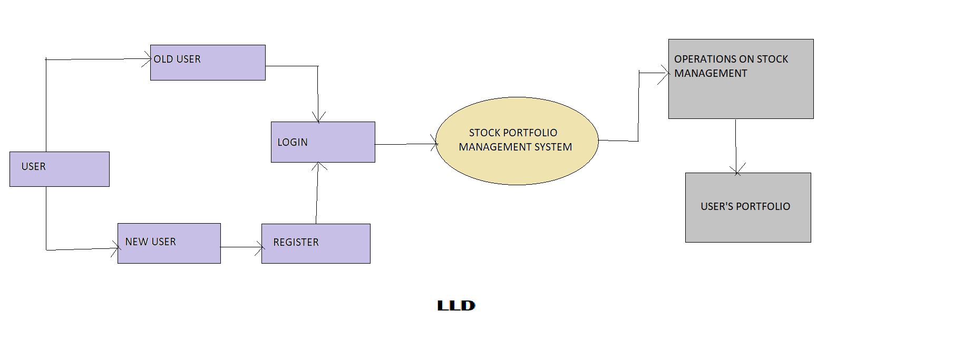
DFD Level 0

Slide 9
DFD Level 1
Authentication Flow Chart
Register
Login
Change password
Auth User information
Username
+
password
Validation
Throw Error
No
Yes
Authenticated
Enter into DMAT account

Slide 10
FLOW CHART
Start
Correct Username & Password
Login
No
Yes
1
Main Menu
Enter Option
0<=option<=6
No
Yes
Exit
Stock Modifications
Search Stock
View Stock Details
Daily Price Updates
Profit and Loss
Add
Delete
Update of Stocks
Enter Stock Name
Count = 1
Max = X
Based On Stock Closer Price
Tax Reports
END
Stock Found
No
Display
Stock Id
Stock Name
Price
Based on Tax Rules of Current FY
Yes
Display
Stock Id
Stock Name
Price
Count+=1
X>Count
Yes
Buy or Sell
1
No

Slide 11
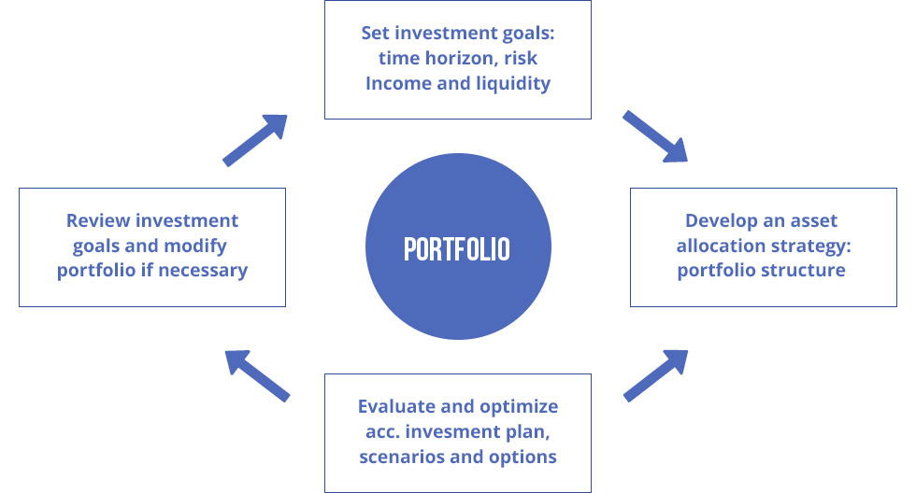
Design :
Stock management system is a process of managing the goods for business plans to sell.

Slide 12
Coding And Execution

Slide 13
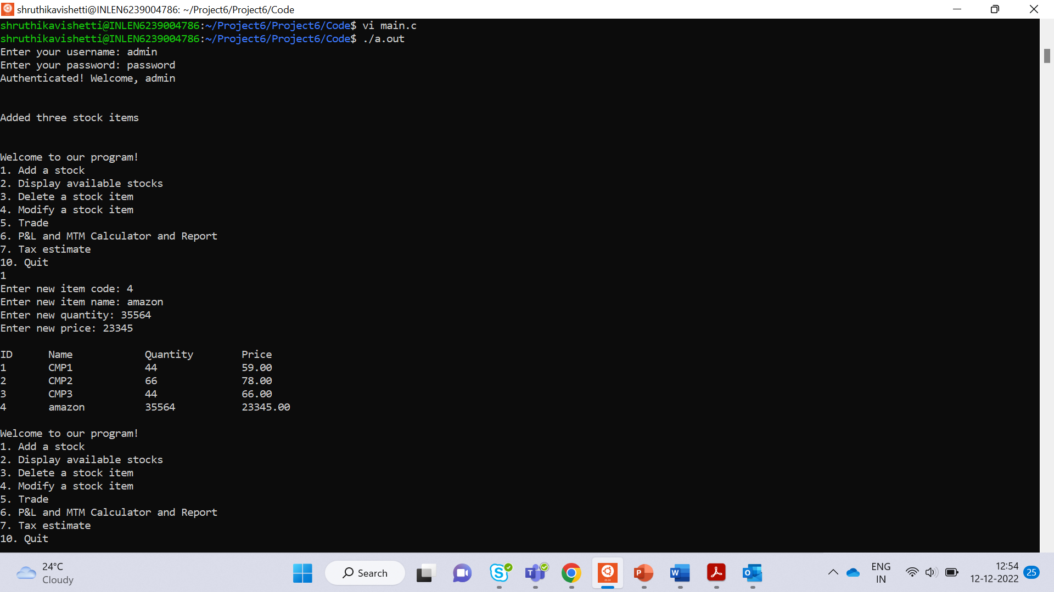
EXECPTED OUTPUT:

Slide 14
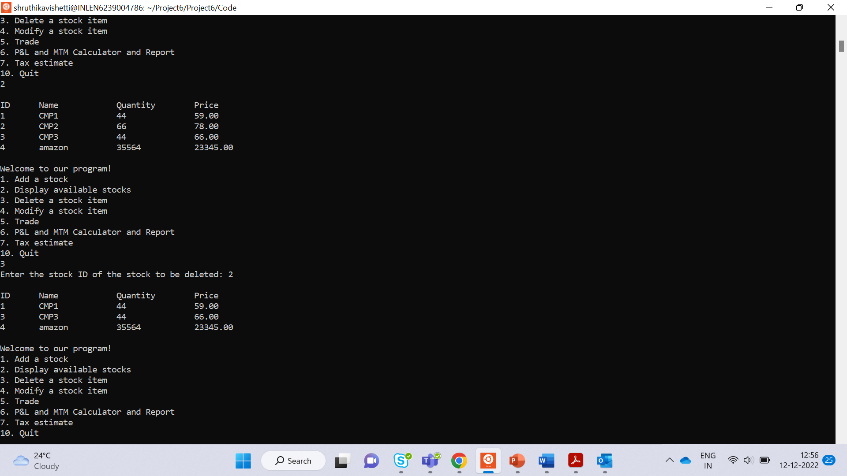

Slide 15
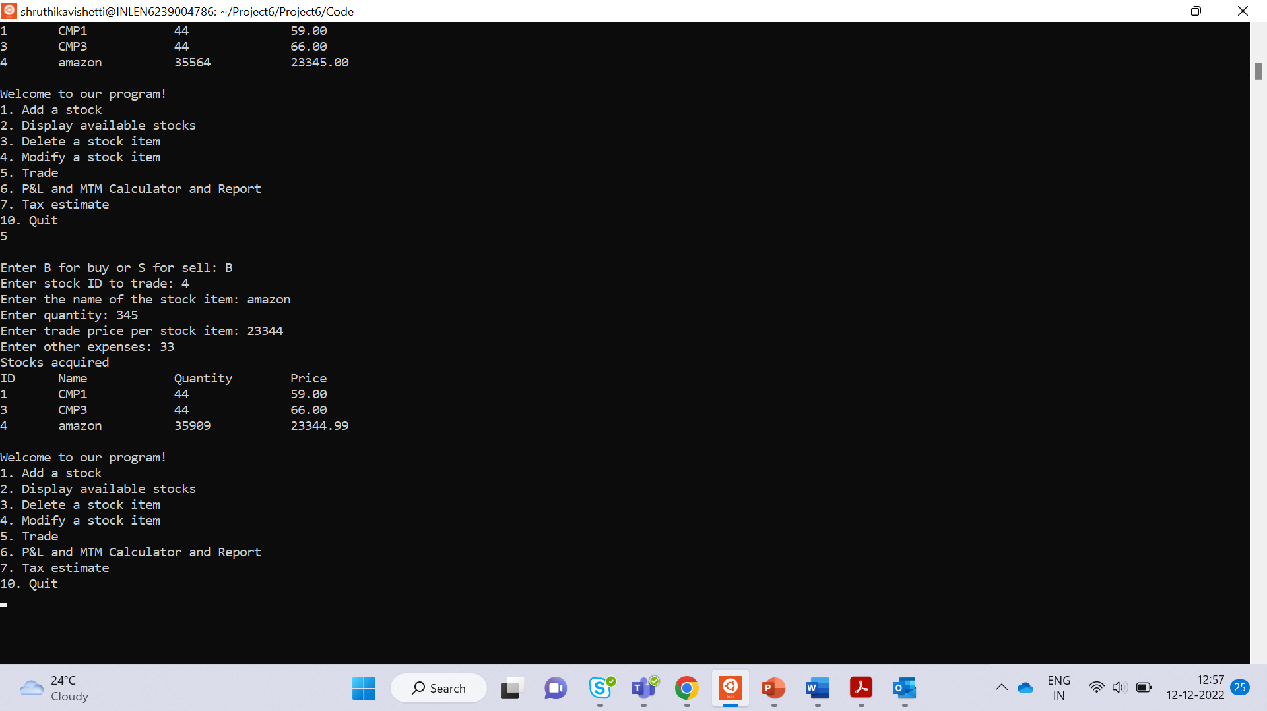

Slide 16
Testing

Slide 17
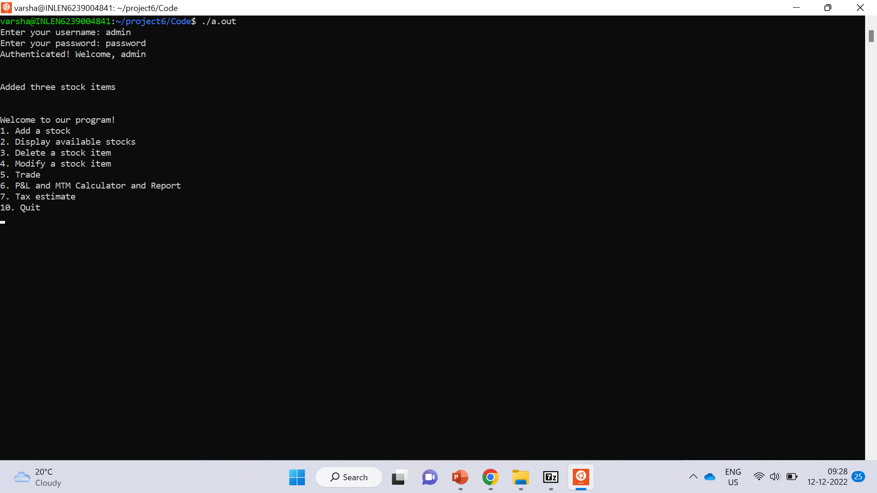
Test case 1:

Slide 18
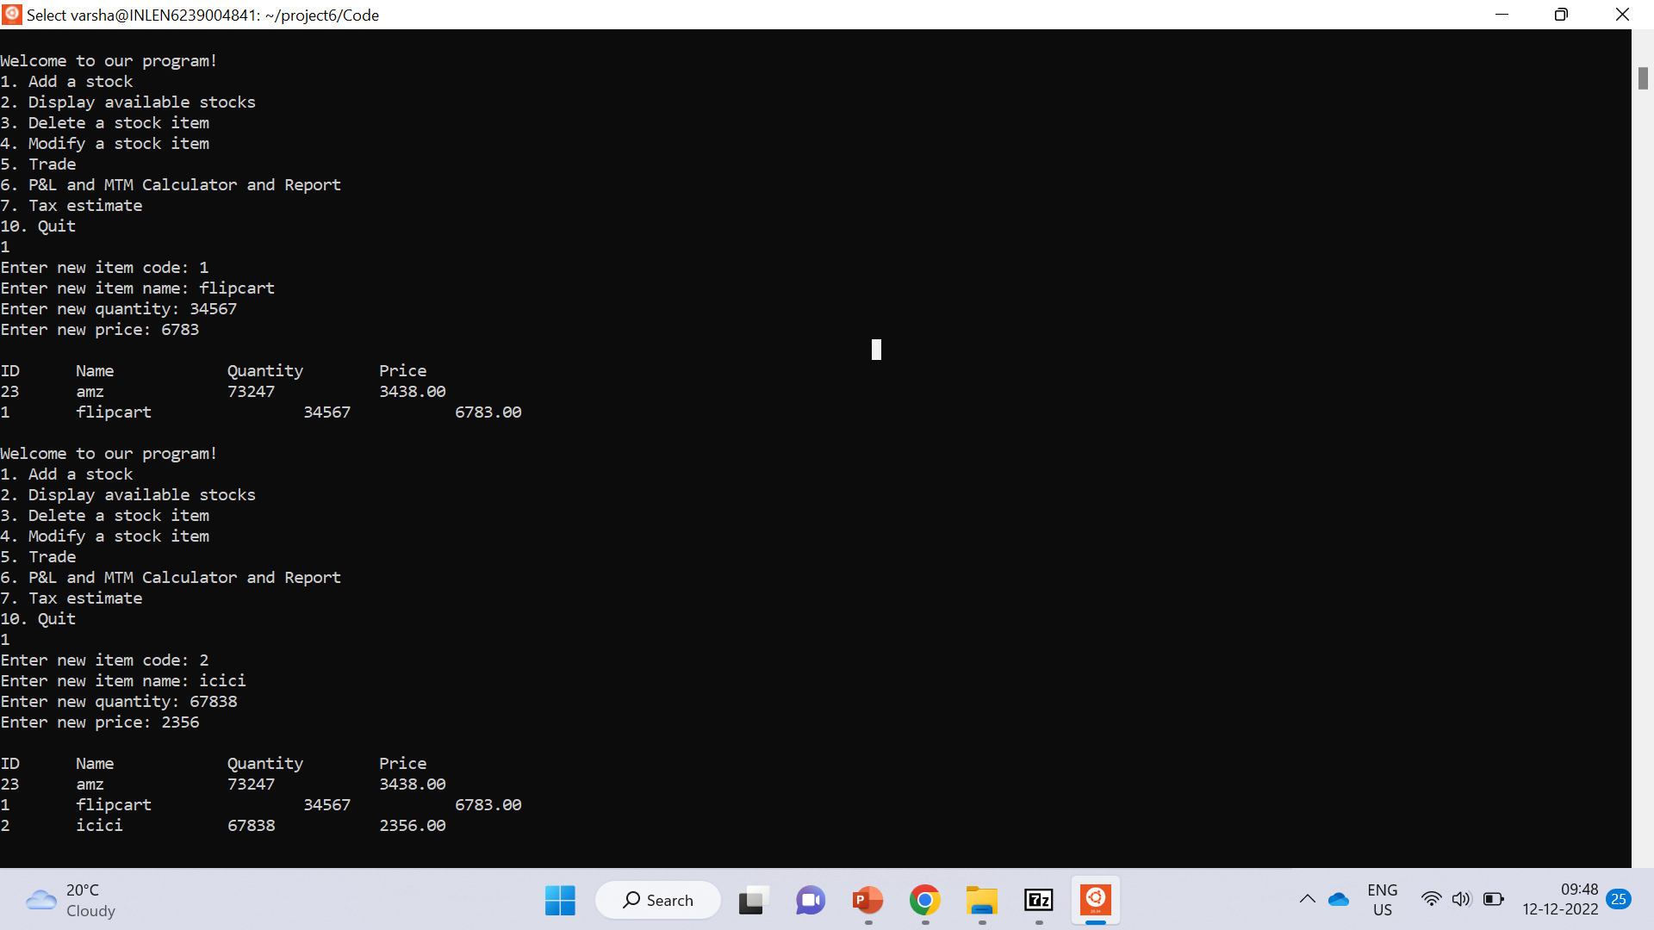
Test case 2:

Slide 19
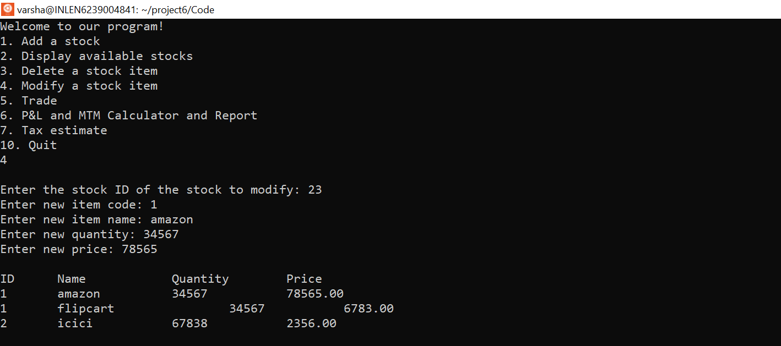
Test case 3:

Slide 20
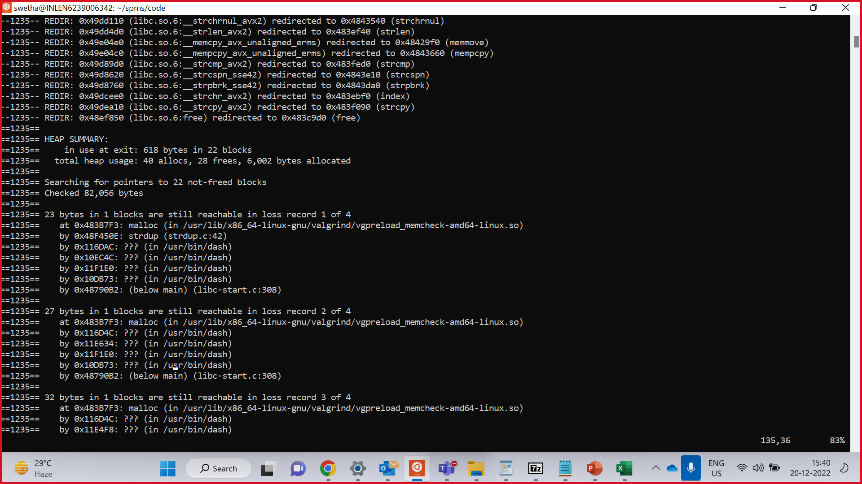
Valgrind tool:
Valgrind is a programming tool for memory debugging, memory leak detection, and profiling.

Slide 21
CHALLENGES FACED
Faced challenges in using file commands.
Took time for us to understand the project.
We use valgrind for the purpose of detecting the memory leak.

Slide 22
CONCULSION
Completed the coding and testing phases as per the given problem statement.
Got the expected results for the automated system with efficiency and time saving method.

Slide 23

GITHUB LINK:
OLD GITHUB LINK:
https://github.com/shruthi-kavishetti/Group6
NEW GITHUB LINK:
https://github.com/Gunaswetha/SPMS-Group6.git

Slide 24

THANK YOU

